Slide 1
Building Cognitive Microservices USING Serverless Framework
Srini Karlekar – Director, Software Engineering, Capital One.
Twitter: @skarlekar
LinkedIn: skarlekar

Slide 2
What is Serverless Architecture?
Serverless Architectures are those models where the applications logic provided by the Developer is run on stateless, compute containers that are provisioned and managed by a provider.
Typically these compute instances are ephemeral (short-lived for the duration of the request-response cycle), typically runs a function and triggered through an event.
Due to the on-demand provisioning nature of this architecture, the systems built using Serverless technologies are inherently scalable and highly responsive under load.
Serverless - No need to configure or maintain infrastructure

Slide 3
The momentum behind serverless
The introduction of function as a service (faaS) as Lambda by Amazon in re:Invent, Nov 2014 (and out of beta in late 2015) created a momentum for "serverless" platform architecture. AWS Lambda was soon followed by most major cloud platform vendors, including IBM, Microsoft, Google and, more recently, Oracle. Serverless is a cloud-native platform model.
Per Gartner, by 2022 most cloud architectures will evolve to a fundamentally serverless model rendering the cloud platform architectures dominating in 2017 as legacy architectures¹.
Serverless is a cloud-native platform model and reflects the core-promise of cloud-computing by offering agility and capability on demand at a value price.
Amazon started the trend with Lamda

Slide 4
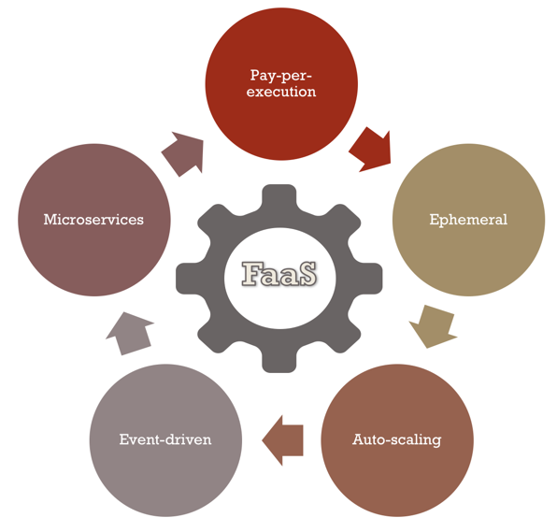
Function as a Service (Faas)
FaaS - The technique of building applications using Serverless architecture.
Cost Efficiency – Pay per execution model is most efficient at managing costs.
Ephemeral – Short-lived process triggered via event.
Auto-scaling – Compute resources are provisioned granularly per request.
Event-driven – Functions respond to events such as http, file drop, alerts, timer, topics etc
Microservices – Modules built to satisfy a specific goal and uses a simple, well-defined interface.
FaaS – Applications Built with Serverless Architecture
Notes:
The technique of building applications using Serverless architecture is known as FaaS (Function as a Service).
The reason becomes clear when you contrast FaaS applications with the traditionally built applications or PaaS (Platform as a Service) where there is a perpetual process running on a server waiting for HTTP requests or API calls.
In FaaS there is no perpetual process (for the most part) but an event mechanism that triggers the execution of a piece of code, usually just a function. You still need a perpetual gateway that will field your API calls to start the events to cascade.
The other key operational difference between FaaS and PaaS is scaling. With most PaaS solutions you still need to worry about scale. With FaaS the compute resources are provisioned at a request level. You cannot get the same level of granularity with PaaS applications even if you set it to auto-scale.
As a result of this, FaaS applications are extremely efficient when it comes to managing cost.

Slide 5
Limitations of Faas – State & Duration
State - Due to the ephemeral nature of the FaaS architecture, the state of your application should be managed externally from the FaaS infrastructure or off-loaded to a cache or data-base.
Duration - Because of the on-demand provisioning and low-cost nature of the FaaS solution there is a restriction on how long your functions are allowed to run. To keep the price low - as you are billed by minutes of usage, some providers such as Amazon AWS and Microsoft Azure restrict the duration of time a function is allowed to process a request.
State between Requests must be maintained outside of FaaS

Slide 6

Limitations of Faas - Resource limits
Deployment & Resource Limits - Some providers such as AWS have deployment limits on the size of the deployment package, code and libraries that can be deployed in the package.
This could be severely limiting for some applications such as image processing functions that depend on large libraries that have to be packaged along with the code.
Additionally, there are limits on the number of concurrent function executions, ephemeral disk capacity (temp space) etc.
While some of these limits are soft limits and can be reconfigured per function by working with the providers, others are hard limits and will force you to reevaluate the choice of your design.
Resources are limited – Use Wisely

Slide 7
Limitations of Faas - Latency
Latency - Due to the on-demand provisioning nature of the FaaS infrastructure, applications that uses languages such as Java/Scala that require a longer start time to spin up JVMs may encounter longer runtime.
Having said that, providers optimize the infrastructure spin-ups based on the usage patterns of the functions.
On the other hand, due to the interpreted nature of Python and Javascript, functions written in these languages may not see a significant difference in latency between a PaaS and FaaS offering.
Test the performance of your applications thoroughly

Slide 8
The players
While there are new providers entering the market to exploit the Serverless wave, the following rule the roost:
Amazon with its AWS Lambda,
Microsoft with its Azure Functions,
Google with its Google Functions and
IBM with its Openwhisk.

Slide 9
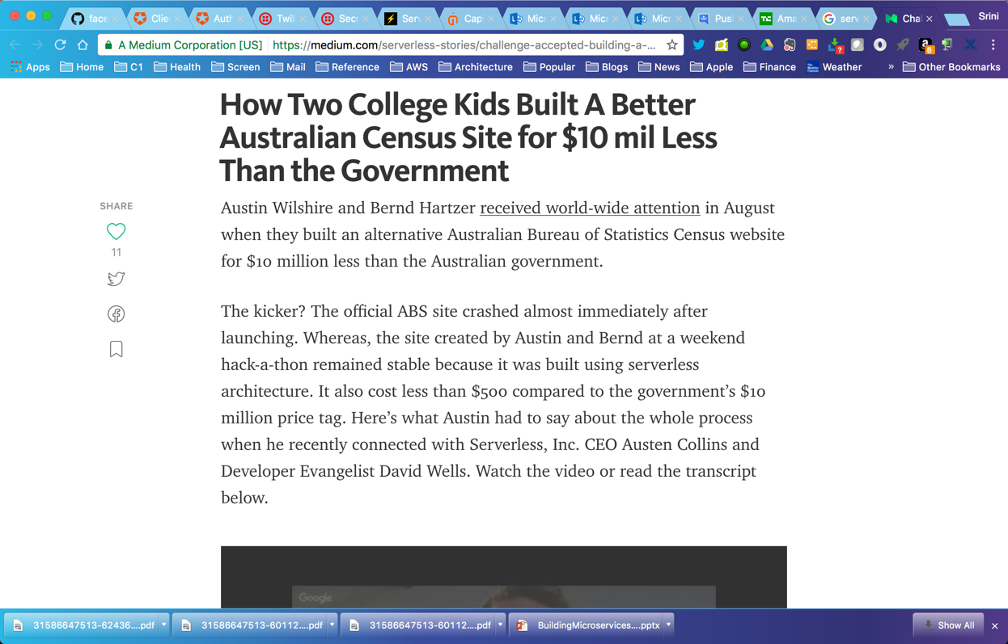
Serverless Stories
http://bit.ly/2qArW04

Slide 10

Serverless framework

Slide 11
Drivers for Serverless Framework
Organizations want to diversify risk and hence do not want to be bound to a single provider.
While not having to manage infrastructure by using serverless functions is nice, having to deal with hundreds of functions in a project between multiple providers, managing buckets, messaging and permissions becomes an issue in itself.
While many providers are entering into the Serverless field to make developing cloud-native applications easy, you are still bound to idiosyncrasies of the provider when it comes to their FaaS offering.
Not only do you have to learn the different terminologies used by the various providers, you will have to learn how to use their offerings on their respective consoles or CLI (Command Line Interface).
Too many cooks spoil the broth

Slide 12
Serverless Framework to the rescue
The Serverless Framework is an MIT open-source project, actively maintained by a vibrant and engaged community of developers and provides robust plugins for various FaaS providers and allows to extend it when needed.
The Serverless Framework allows you to provision and deploy REST APIs, backend services, data pipe-lines, and other uses cases by providing a framework and CLI to build serverless services across many providers by abstracting away provider-level complexity.
The Serverless Framework is different than other application frameworks because:
It manages your code as well as your infrastructure
It supports multiple languages (Node.js, Python, Java, and more)
Serverless framework allows choice of FaaS providers across a single project

Slide 13
Core Concepts of Serverless FrameWORK
Serverless Framework consists of the following core concepts:
Service
Function
Events
Resources
Plugins

Slide 14
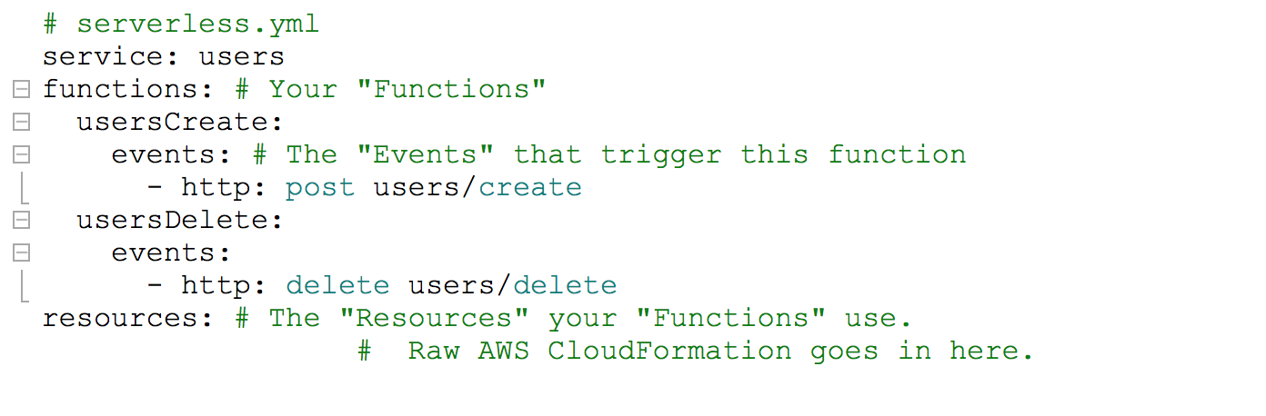
Services
Service - The unit of organization. It's where you define your Functions, the Events that trigger them, and the Resources your Functions use, all in one file titled serverless.yml. More information at: https://goo.gl/9SKBvx
An application can have multiple services and hence multiple serverless.yml files.

Slide 15
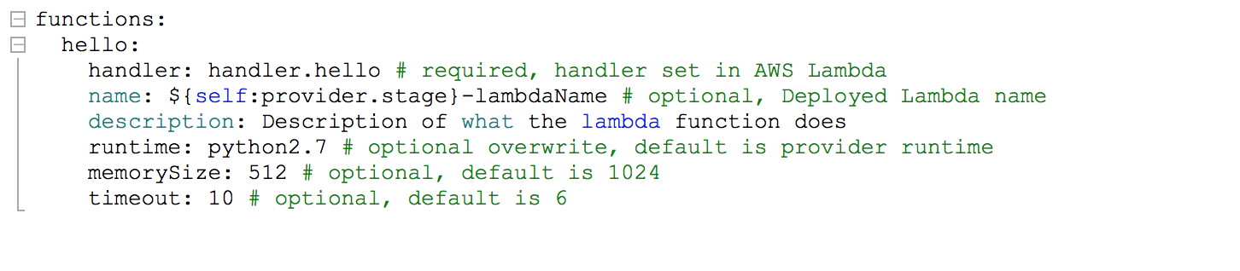
Functions
Functions - A Function is an independent unit of deployment or microservice. It manifests itself as a Lambda or Azure Function depending upon the provider. It's merely code, deployed in the cloud, that is most often written to perform a single job such as:
Saving a user to the database
Processing a file in a database
Performing a scheduled task

Slide 16
Events
Anything that triggers an Function to execute is regarded by the Framework as an Event.
Events on AWS are:
An AWS API Gateway HTTP endpoint request (e.g., for a REST API)
An AWS S3 bucket upload (e.g., for an image)
A CloudWatch timer (e.g., run every 5 minutes)
An AWS SNS topic (e.g., a message)
A CloudWatch Alert (e.g., something happened)
When you define an event for your functions in the Serverless Framework, the Framework will automatically create any infrastructure necessary for that event (e.g., an API Gateway endpoint) and configure your Functions to listen to it.

Slide 17
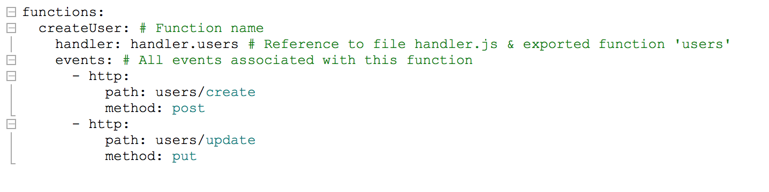
Events
Simply put, events are the things that trigger your functions to run. If you are using AWS as your provider, all events in the service are anything in AWS that can trigger an AWS Lambda function, like an S3 bucket upload, an SNS topic, and HTTP endpoints created via API Gateway.
Upon deployment, the framework will deploy any infrastructure required for an event (e.g., an API Gateway endpoint) and configure your function to listen to it.

Slide 18
Resources
Resources are infrastructure components which your Functions uses.
If you use AWS as you provider, then resources are:
An AWS DynamoDB Table (e.g., for saving Users/Posts/Comments data)
An AWS S3 Bucket (e.g., for saving images or files)
An AWS SNS Topic (e.g., for sending messages asynchronously)
Anything that can be defined in CloudFormation is supported by the Serverless Framework
The Serverless Framework not only deploys your Functions and the Events that trigger them, but it also deploys the infrastructure components your Functions depend upon.

Slide 19
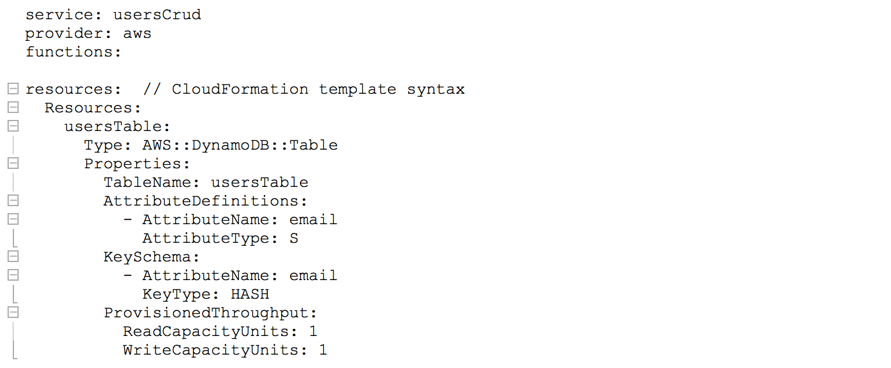
Resources
An example of resources in Serverless Framework using AWS as provider:

Slide 20
Credentials
Serverless Framework needs access to your cloud provider account credentials to deploy resources on your behalf. For AWS you can use AWS CLI (aws configure). Azure is more involved.
Following links provide excellent guidance on setting up the credentials for various providers currently supported on the Serverless Framework.
AWS - https://serverless.com/framework/docs/providers/aws/guide/credentials/
Azure -https://serverless.com/framework/docs/providers/azure/guide/credentials/
Google - https://serverless.com/framework/docs/providers/google/guide/credentials/

Slide 21
Create Service
Create a new service using the Python template on Amazon, specifying a unique name and an optional path for your service.
serverless create --template aws-python --name helloWorld --path helloWorldService
Serverless framework will now create the service declaration for the helloWorld service in directory helloWorldService.

Slide 22
Deployment
Serverless Framework translates the service declaration in the serverless.yml file into a Cloud Formation or Resource Manager template depending upon the provider you choose.
To deploy your service, all the functions and provision the resources, enter:
serverless deploy --verbose
To deploy a single function after making changes to it, enter:
serverless deploy function --function <myfunction> --verbose

Slide 23
Invoking
Serverless Framework allows you to invoke a function locally for testing or invoke a deployed function.
To invoke your function locally, enter:
serverless invoke local --function <myfunction> --log
To invoke a deployed function, enter:
serverless invoke function --function <myfunction> --stage <my stage> --region <myregion>
Note: If you omit the stage and region option, the default stage (dev) and region specified in your provider configuration will be used.

Slide 24
Artificial Intelligence as a Service
Cognitive Services are machine learning services that makes your applications more intelligent, engaging and discoverable.
These cognitive services expands on machine learning APIs and enables developers to easily add intelligent features – such as emotion and video detection; facial, speech and vision recognition; and speech and language understanding – into their applications.
The leading cloud providers such as Google, Amazon, Microsoft and IBM provide a portfolio cognitive services that are API-driven and easy to use.
These pre-packaged, API-driven cognitive function as a service is also called AIaaS or Artificial Intelligence as a Service.
AIaaS service is billed in the same fashion as other serverless services for the compute and storage by the minute unless noted otherwise by the provider.
AIaaS – API-driven, Pre-packaged Cognitive Services

Slide 25
Bot Chehara - Application DEMO

Slide 26
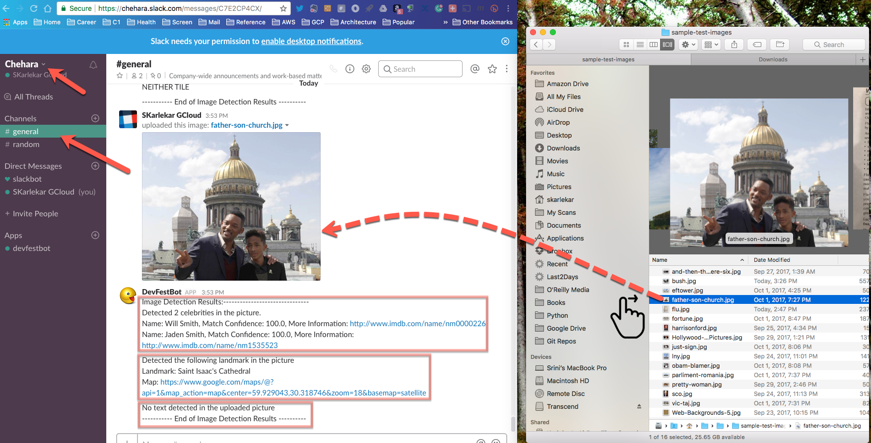
Bot CHehara - SCreenshots

Slide 27
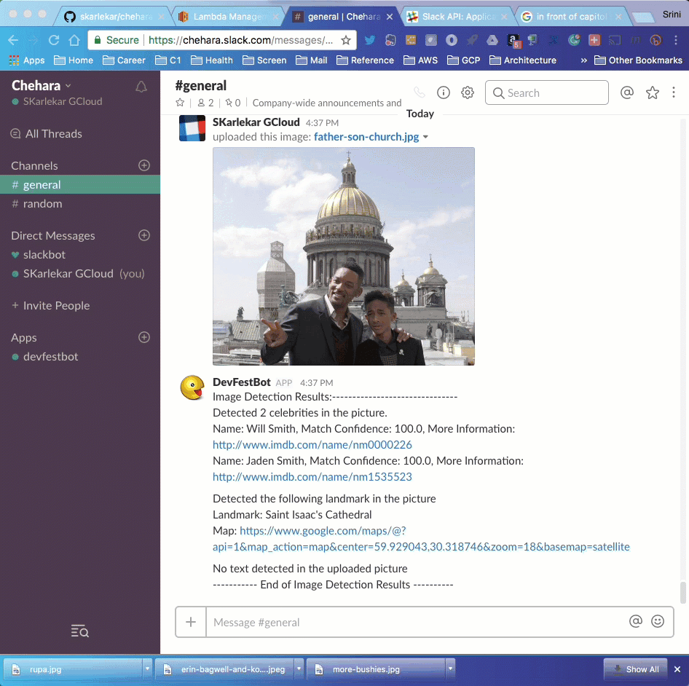
Bot Chehara – Pre-Recorded Demo – Celebrity Detection

Slide 28
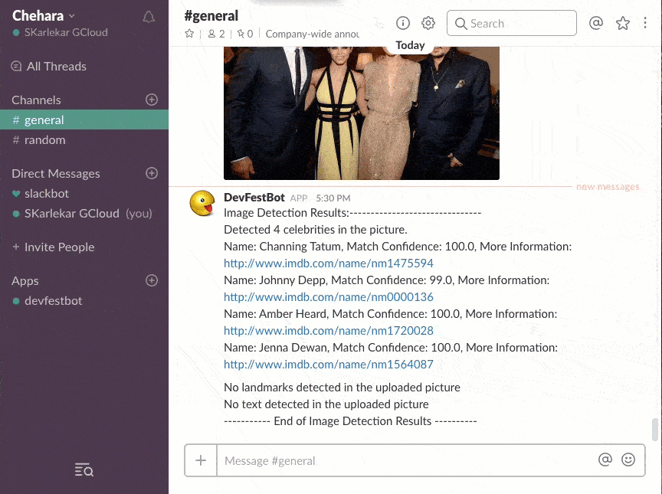
Bot Chehara – Pre-Recorded Demo – Landmark Detection

Slide 29
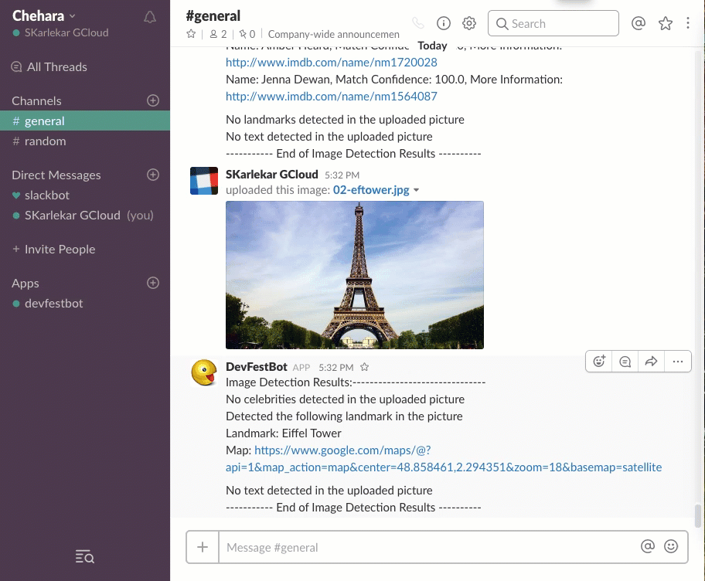
Bot Chehara – Pre-Recorded Demo – Text Detection

Slide 30
Bot Chehara

Slide 31
BOT Chehara – The Bot Who could not forget
BotChehara is a Slack Bot that recognizes pictures of celebrities, famous landmarks and extracts texts from pictures of documents. Chehara is Hindi for Face. BotChehara was inspired by the SMSBot faces (see: http://github.com/skarlekar/faces).
BotChehara is 100% Serverless AIaaS¹ micro-service built on top of the Serverless Framework and uses Python, SlackAPI, AWS StepFunctions, AWS Rekognition and Google Vision API. You can invite BotChehara to your SlackWorkspace.
Whenever a picture is posted on the invited channel, BotChehara will analyze the picture to identify faces of celebrities, famous landmarks and post the biography or description & map of the landmark back to the channel. If a picture of a scanned document or signage is uploaded, the bot detects text and posts the extracted raw text back to the channel.
BotChehara code repository, installation guide and usage at: https://github.com/skarlekar/chehara

Slide 32
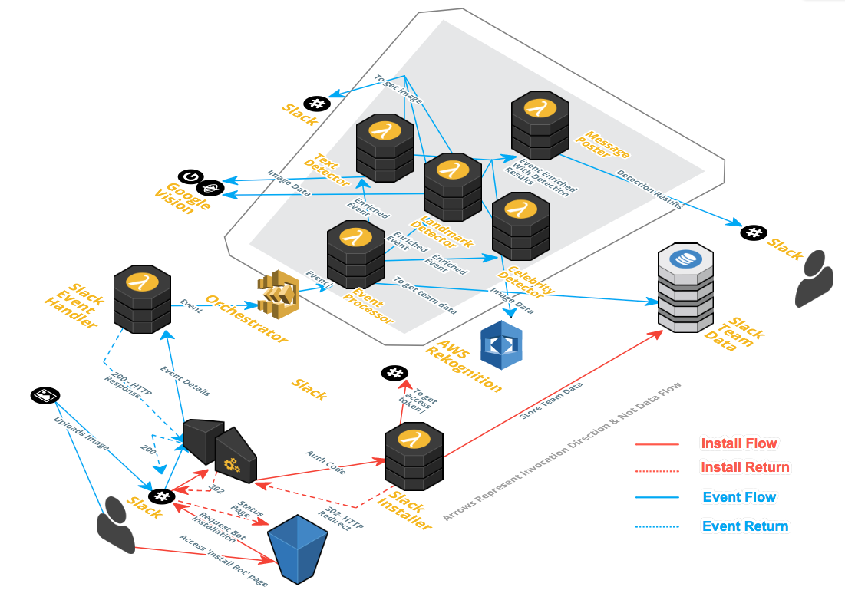
Bot Chehara - Architecture

Slide 33
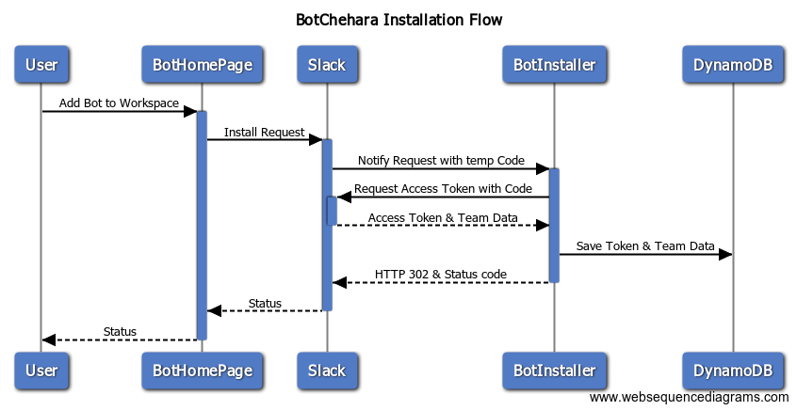
Bot Chehara – Installation Flow
For details go to: http://bit.ly/bcinstallflow

Slide 34
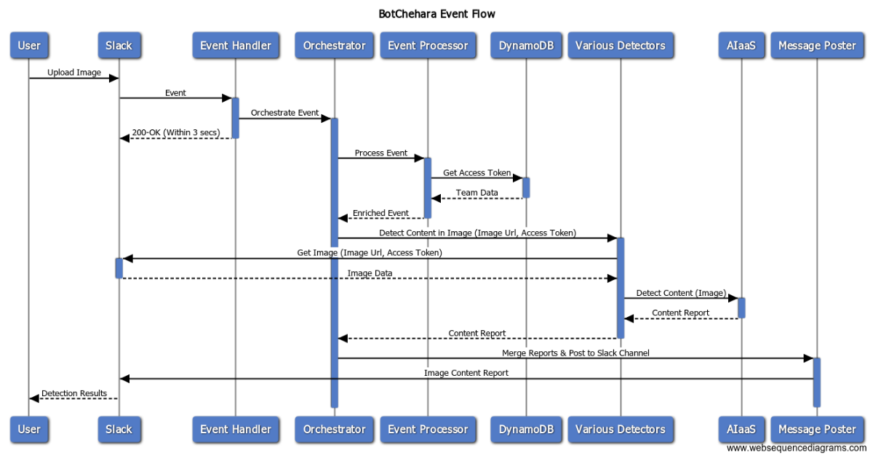
Bot Chehara – Event Flow
For details go to: http://bit.ly/bceventflow

Slide 35
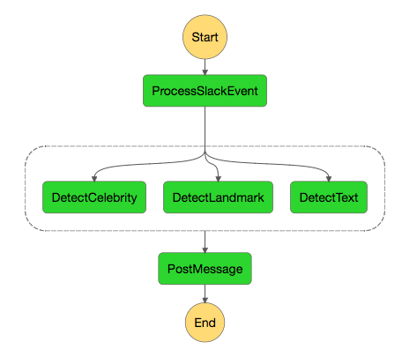
Bot Chehara – Orchestrator
For details go to: http://bit.ly/bcorch

Slide 36
Bot Chehara – Code Walk-Through
The CelebritySleuth application can be cloned from:
https://github.com/skarlekar/chehara
For Installation, Deployment and Usage instructions go to:
http://bit.ly/chehara

Slide 37
Further Exploration
For further demonstration of using Serverless Framework to Deploy & Manage Serverless Micro-services across AWS and Google Cloud Platforms, see:
https://github.com/skarlekar/aws-gcp-proxy-serverless
This is an simple tutorial to demonstrate how to deploy multiple services on different cloud providers using the Serverless Framework.
More specifically, this tutorial walks you through deploying an image detection service on Google Cloud Platform (GCP) and managing it using a proxy service running on Amazon Web Service. Both the services on either platform is 100% serverless.
The image detection service running on GCP uses Google's FaaS solution viz., Cloud Functions and the proxy running on AWS uses Amazon's FaaS solution viz., Lambda.

Slide 38
Further READING
To understand the concept of Serverless and explore the differences between Serverless Architecture and Serverless Framework go to:
http://bit.ly/slswhite

